Slide 1
May 2021 OGC API Virtual Code Sprint
May 26, 2021
#OGCAPI

Slide 2
Housekeeping
Only switch your microphone on when speaking.
Follow the chair/facilitator’s instructions.
Say your name before speaking...
“Hi, this is Gobe…”

Slide 5
Welcome
What is an OGC Code Sprint?
A collaborative and inclusive event driven by innovative and rapid programming with minimum process and organization constraints to support the development of new applications and open standards.
The scope of the code sprint is to include:
API implementation
API testing and feedback
Discussion and knowledge sharing
Objectives of the code sprint
Develop prototype implementations of OGC API – Maps
Develop prototype implementations of OGC API – Tiles
Develop prototype implementations of OGC API – Styles
Test the prototype implementations
Provide feedback to the Editor about what worked and what did not work
Provide feedback about the specification document, especially what is missing from the document

Slide 6
Motivation
APIs are a popular, effective method for rapid software development
There is an increasing need for interoperability between Web APIs
The growing uptake of location within and beyond geospatial developer communities

Slide 7

Gold-level Sponsor
http://os.uk

Slide 8
This Code Sprint is sponsored by
Gold-level Sponsor
Silver-level Sponsor

Slide 9
Cost Share Funding
Application Form and Eligibility Details at https://docs.google.com/forms/d/1NK9zJlwaUNKV0_yAHsZXtI3mzOA9riNAu86iP1RzSo0

Slide 10
User Needs and Use Cases

Slide 11
Overview of the draft specification
OGC API – Maps – Part 1: Core

Slide 12
Overview of the draft specification
OGC API – Tiles – Part 1: Core

Slide 13
Overview of the draft specification
OGC API – Styles – Part 1: Core

Slide 14
Supported Use Cases
A Styles API supports several types of consumers, mainly:
Web APIs implementing the draft OGC API - Maps specification fetch styles and render spatial data
Map clients fetch styles and render spatial data
Visual style editors that create, update and delete styles for datasets

Slide 15
Key Concepts / Resources
Style
the main resource
Stylesheet
each style is available in one or more stylesheets - the representation of a style in an encoding like OGC SLD 1.0 or Mapbox Style
Style Metadata
metadata about a style with general descriptive information about the style, structural information (e.g., layers and attributes), and so forth to allow users to discover and select existing styles for their data
all information in the metadata is optional

Slide 16
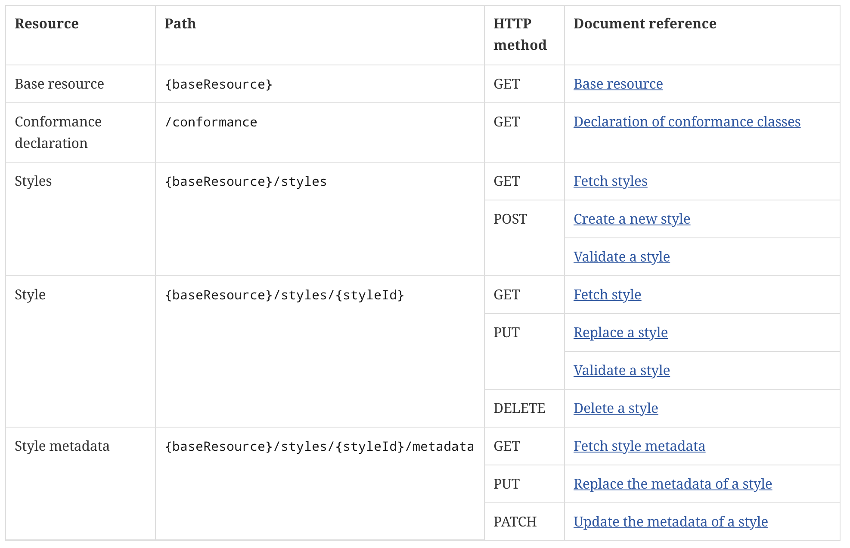
Resources and Operations

Slide 17
Status
Multiple implementations are available, initial developments during the Vector Tiles Pilots and Testbed 15
The working group has processed most open issues
Recently several changes have been made as a result
A Styles resource is no longer tied to the landing page and can also be, for example, associated with a feature collection resource
Use of Prefer header preference "handling" to control validation
Removed conformance classes that are no longer needed or do not belong into the Core standard (managing style resources like symbols, sprites, fonts; queryables; style information in Collection resources)
Updates to align with other OGC API work (use of Common Core instead of referencing Features Core, use of Create/Replace/Delete and Update currently in Features Part 4) and other clarifications or editorial updates
Before the Sprint, interactive instruments will provide a server that implements the current draft specification and provides access to OS Open Zoomstack style resources

Slide 18
Sprint goals
Get implementation feedback
In general
On the open issues
On the recent changes
Test how Styles, Tiles and Maps fit together
Get an idea about the maturity of the current specification - how far are we from moving forward in the standardization process?

Slide 19
Open issues
#13: How to identify that a style can be applied to a data resource?
#5: Formulation of SLD stylesheets
#3: Do we need to be more restrictive in updates to style metadata?
Also:
#12: Support for symbol and font collections
#14: Support for stylesheet modifiers
#4: Support for 3D

Slide 20
Sprint Description
The scope of the code sprint is to include:
API implementation
API testing and feedback
Discussion and knowledge sharing
Participants are welcome to bring partial or complete implementations of servers or clients to support the sprint.
Participants will have the opportunity to experiment with parts of the specifications and develop working implementations.

Slide 21
Ways of Working
Participants are welcome to bring partial or complete implementations of servers or clients to support the sprint.
Participants will have the opportunity to experiment with parts of the specification and develop working services.
This development can either be done with:
source data that participants bring to the event themselves, or
source data made available by other organizations.

Slide 22
Sprint Cycle
Discuss in Telecon
Implement
Discuss on Gitter
Demonstrate

Slide 23
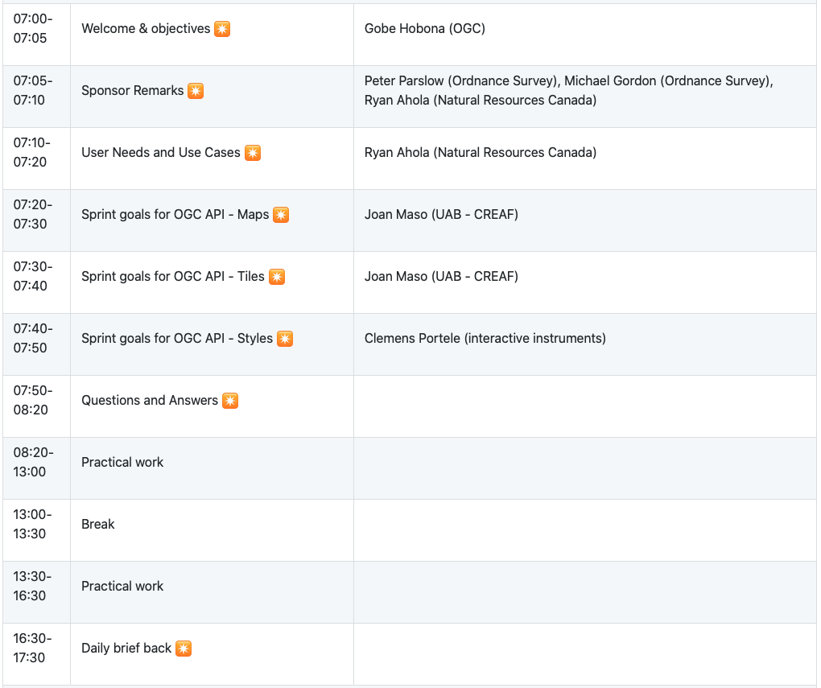
Sprint Schedule – Day 1 – May 26

Slide 24
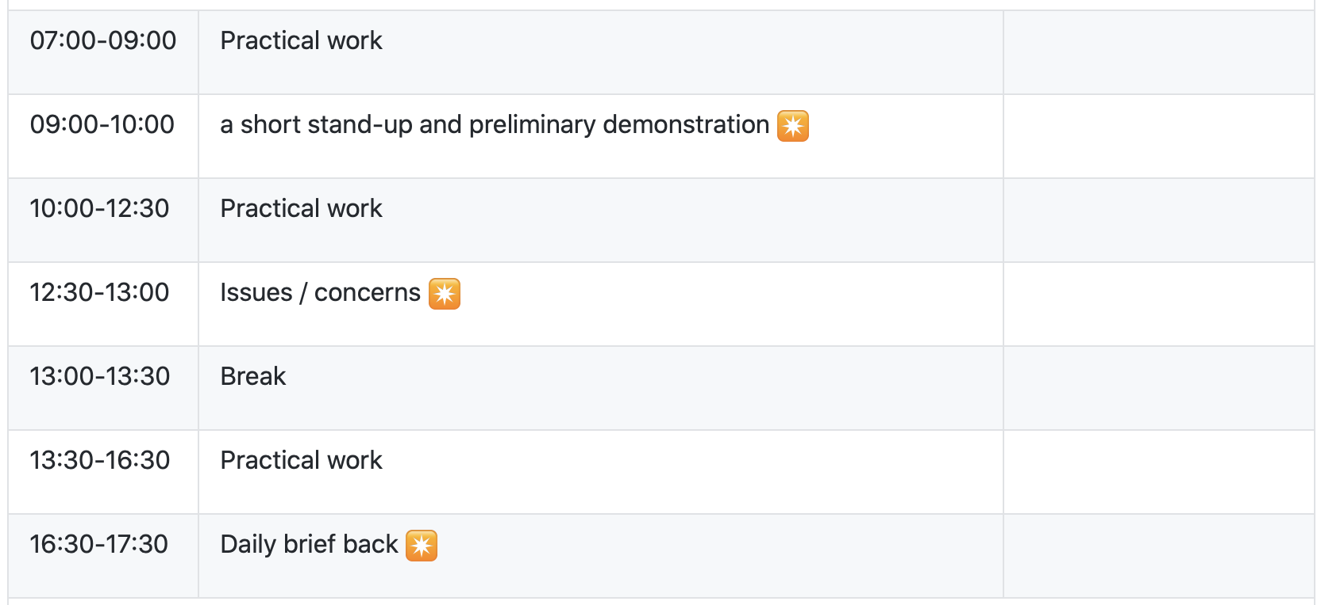
Sprint Schedule – Day 2 – May 27

Slide 25
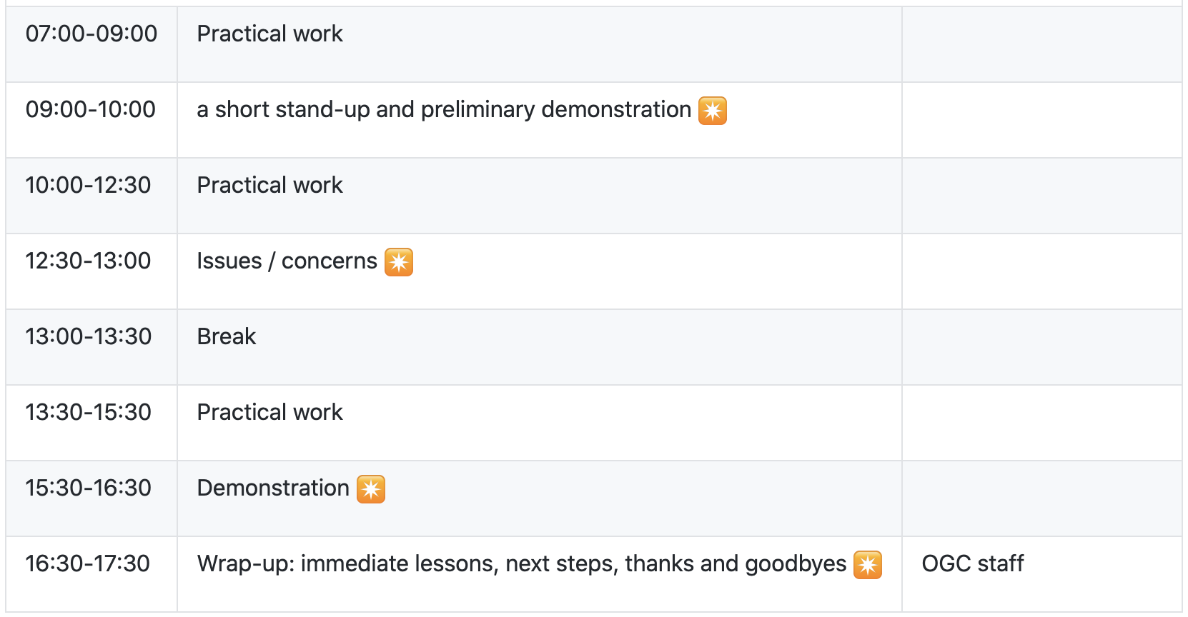
Sprint Schedule – Day 3 – May 28

Slide 26
Logistics
Gotomeeting
https://global.gotomeeting.com/join/953927765
Gitter
https://gitter.im/ogc-developer/Sprints
GitHub
Sprint repo https://github.com/opengeospatial/ogcapi-code-sprint-2021-05

Slide 27
Community
500+ International Members
110+ Member Meetings
60+ Alliance and Liaison partners
50+ Standards Working Groups
45+ Domain Working Groups
25+ Years of Not for Profit Work 10+ Regional and Country Forums
Innovation
120+ Innovation Initiatives
380+ Technical reports
Quarterly Tech Trends monitoring
Standards
65+ Adopted Standards
300+ products with 1000+ certified implementations
1,700,000+ Operational Data Sets Using OGC Standards
Contact info@ogc.org to schedule a meeting for an in-depth discussion with OGC staff and join our community today!
Notes:
If you have any questions, do not hesitate to reach out to OGC or schedule a follow-up. We’re working constantly to change the landscape of location information and want to help your organization get where it needs to go.

